Slide 1
FIRST TERM PROJECT
Pressure Detection| Learn In Depth| Mohamed Elgohary

Slide 2
First term project
Final project 1
Eng: Mohamed Ayman Abd ElAziz Elgohary
Project name: Pressure Sensor
Description
A pressure controller informs the crew of a cabin
with an alarm when the pressure exceeds 20 bars in
the cabin

Slide 3
System Architecting/Design Sequence
System Design
System Analysis
Space
Exploration
Requirement
Method
Case Study

Slide 4
Case Study: a Pressure Controlling System
A pressure controller informs the crew of a cabin
with an alarm when the pressure exceeds 20 bars in
the cabin
The alarm duration equals 60 seconds.

Slide 5
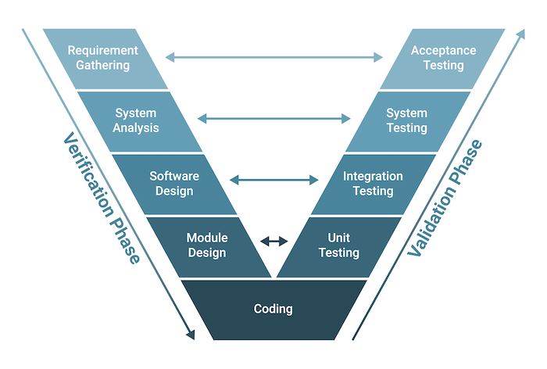
Method
V-Model

Slide 6
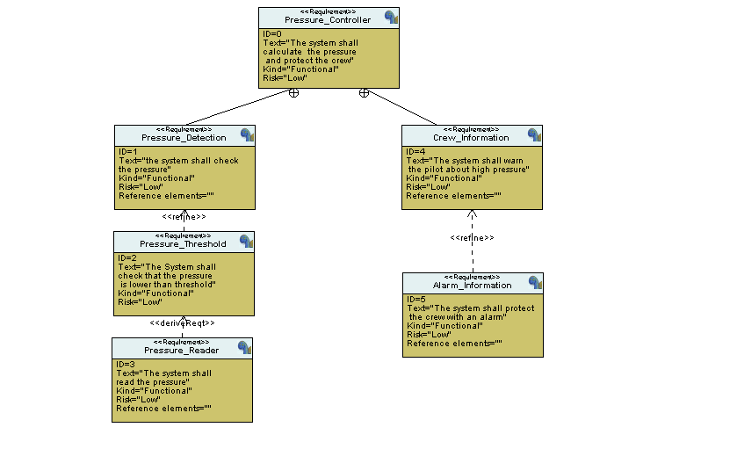
System Requirements

Slide 7
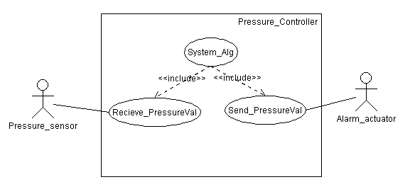
System Analysis
1- Use Case Diagram

Slide 8
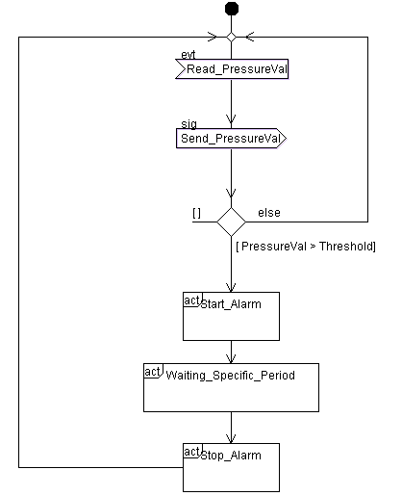
System Analysis
2- Activity Diagram

Slide 9
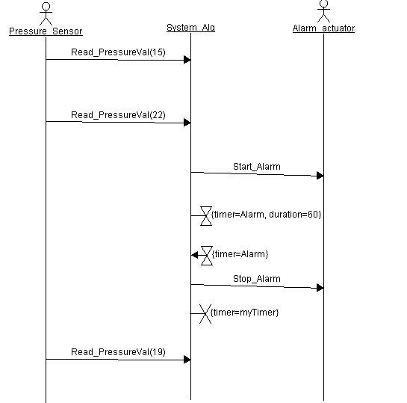
System Analysis
3- Sequence Diagram

Slide 10
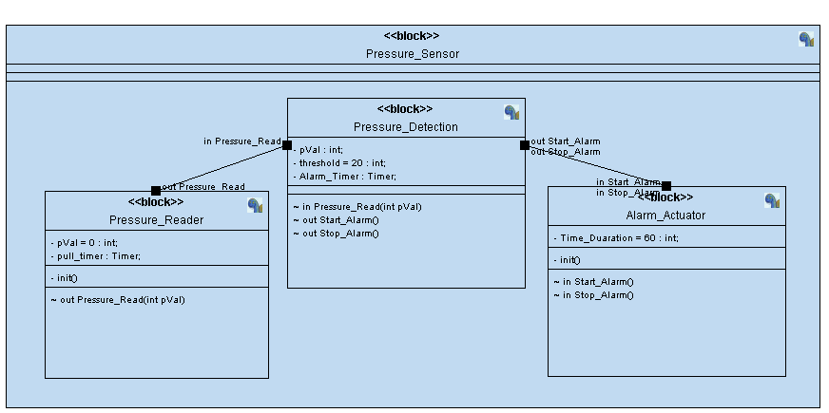
System Design
Blocks

Slide 11
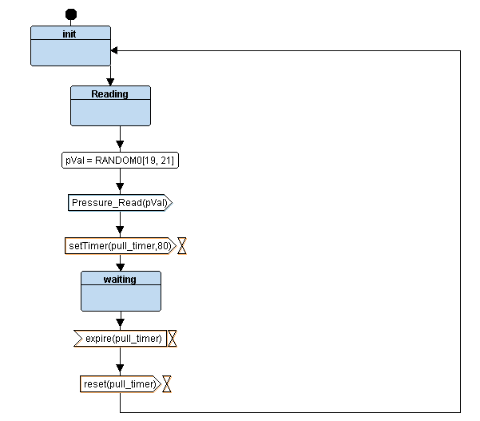
System Design
Pressure Reader

Slide 12
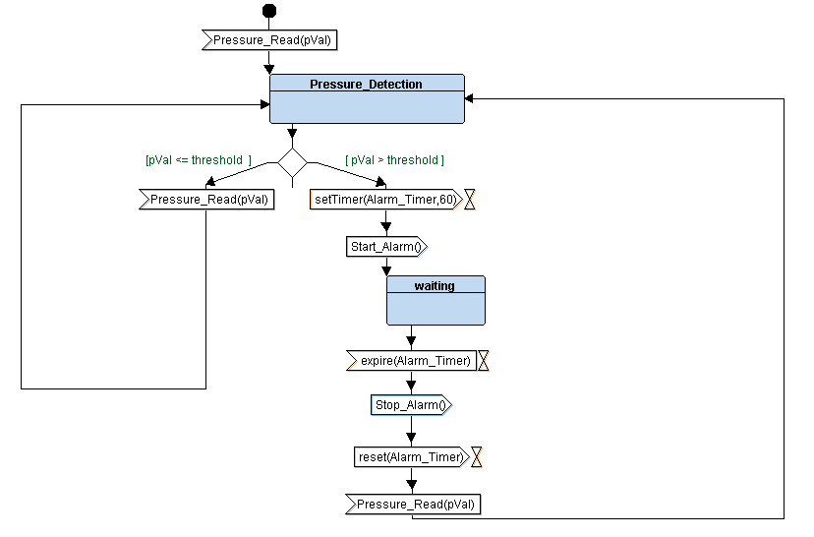
System Design
Pressure Detection

Slide 13
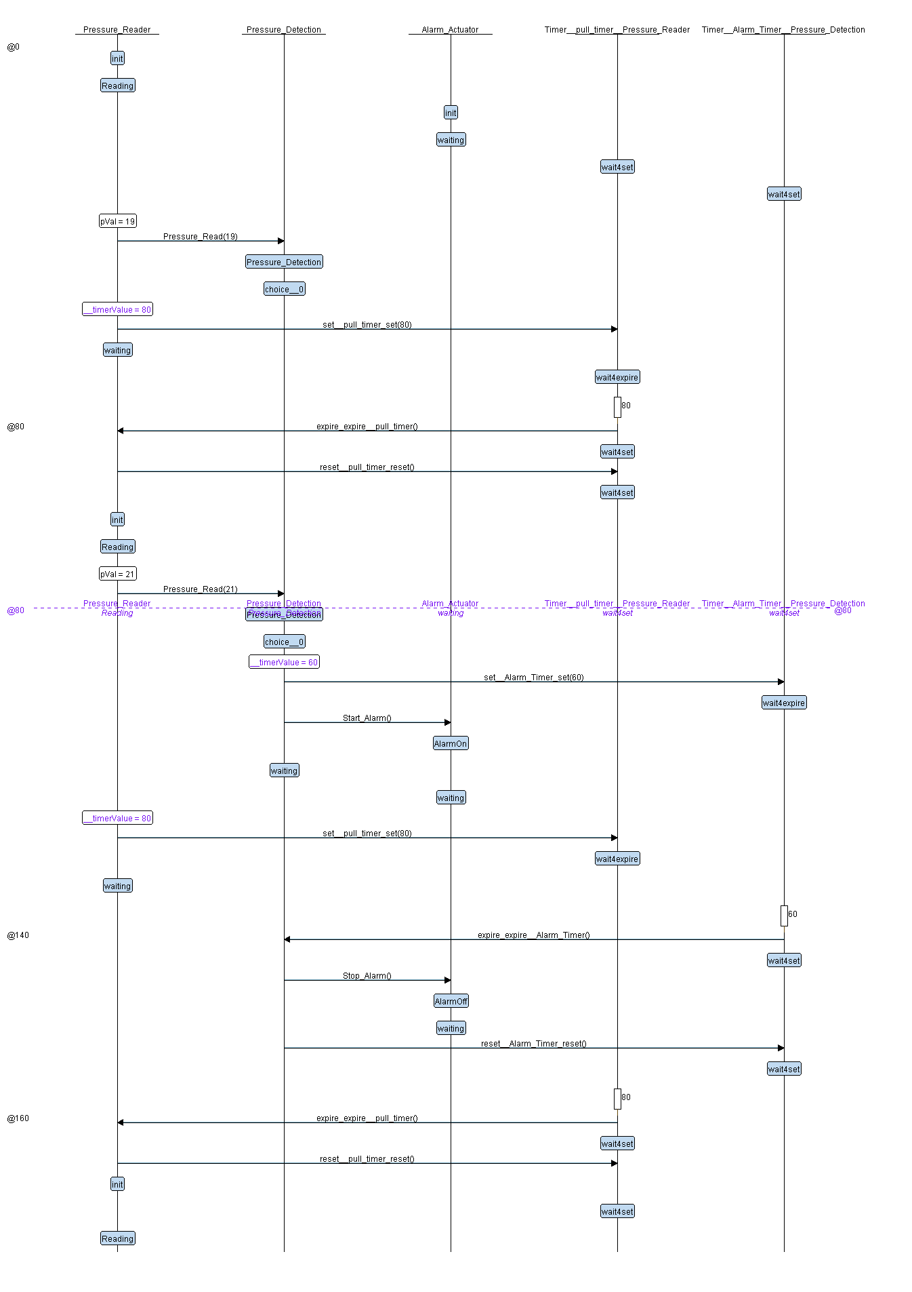
Logic Design

Slide 14
Logic Design

Slide 15
Logic Design

Slide 16
Logic Design

Slide 17
Program implementation
.c&.h Files.
After system anlysis and system design it is time to write the code
.o Files.
And then execute the (.o) files
.map&.elf Files.
And execute (.map), (.elf) and (. hex) files
Section & Symbol tables.

Slide 18
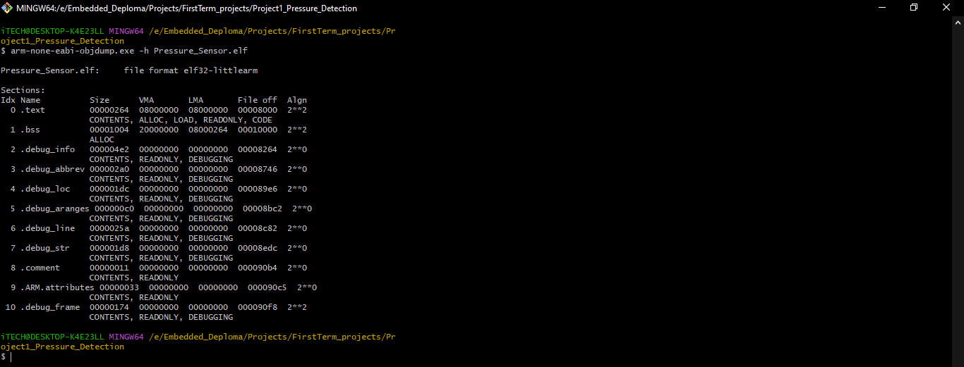
Section table

Slide 19
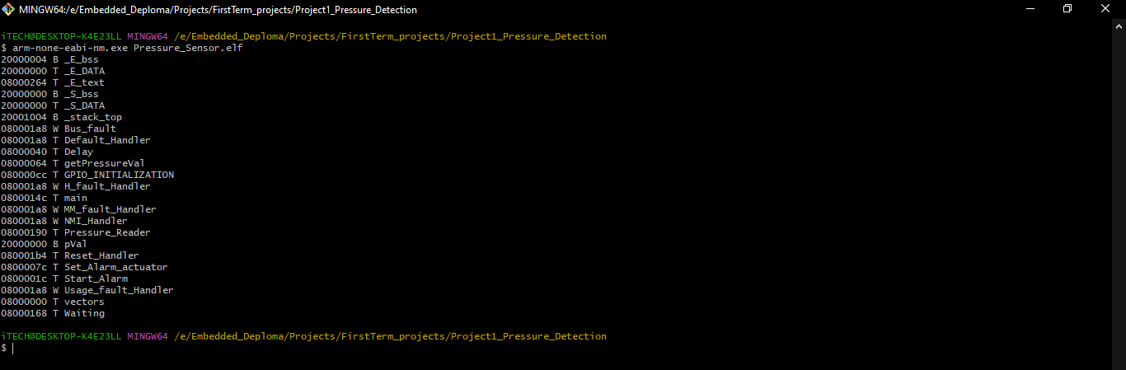
Symbol table

Slide 20
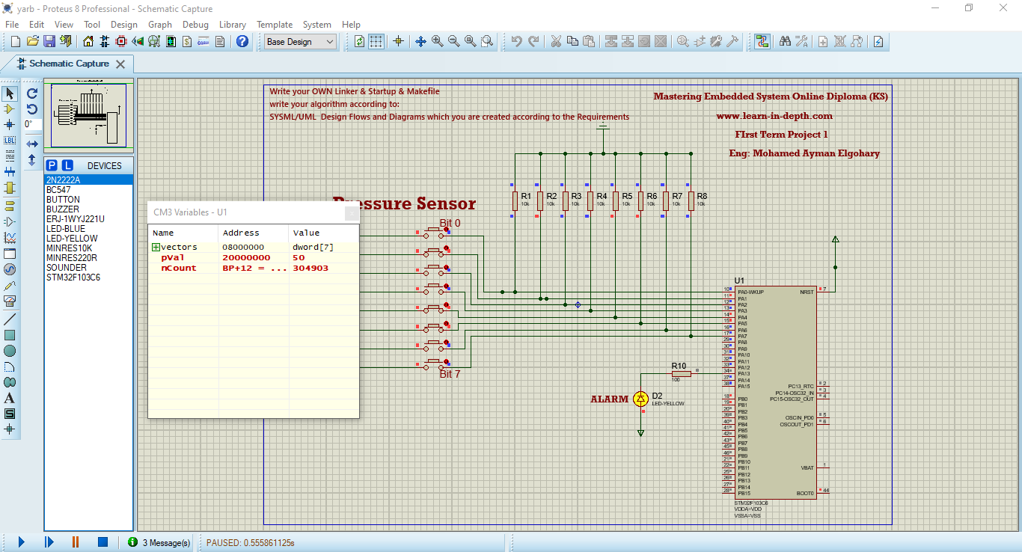
Proteus Run

Slide 21
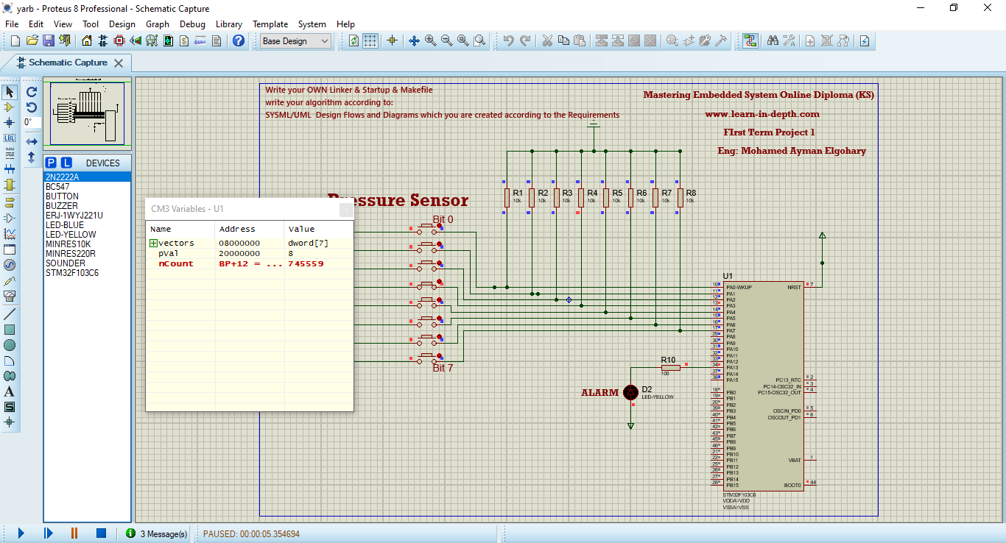
Proteus Run

